Slide 1
Computergrafik
Spiele 2D

Slide 2
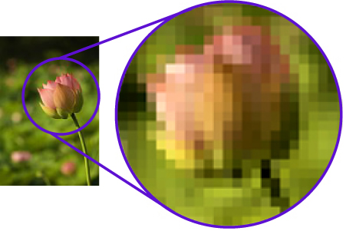
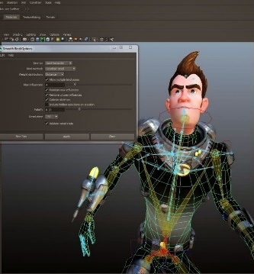

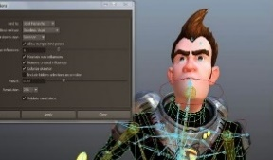
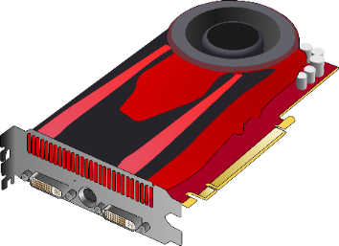
First goal – understand concepts
2D computer graphics (hardware internals, OpenGL)
Rasterization
Textures (Sprites)
Transformations
Culling/clipping
Anti-aliasing
Shader intro
Games
Collision detection
Physics
Rasterisation
3D

Slide 3
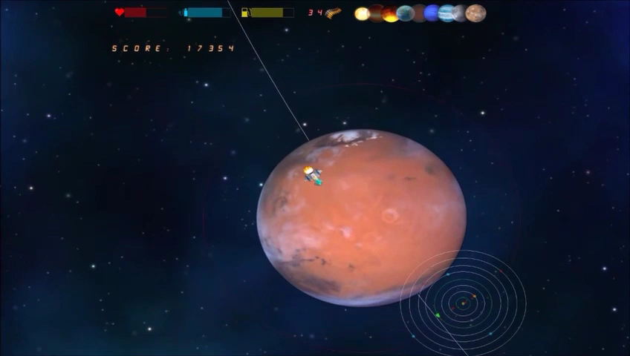
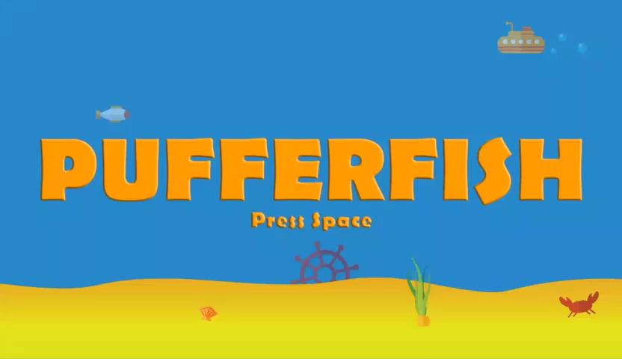
Second goal – practicle work
If done with SE lecture
If advanced students
Big software project
2D sprite-based game
Teams
Number of exercises
Show theory
Mini games
Finish with small game

Slide 4
LVA structure
 | Month 1 |  |  |  | Month 2 |  |  |  | Month 3 |  |  |  | Month 4
1st Part | L | L | L | L | L | L | L | L | L | L | L | L | L | L | L | L
2nd Part | C | G | C | C | C | C | C | P | C | C | C | P | C | C | C | P
Project | prototype |  |  |  |  |  |  |  | game play |  |  |  | final game
L … theory lecture
C … coaching/working (tutors/myself)
P … play testing
G ... game concept

Slide 5



Todo
Form teams of 3-5 person(s)
Create game concept
Implement a 2D game
Team organization
Meetings
Play-testing events
1 minute let’s play video
Form teams of 1-2 person(s)
Work on given exercises
Create small game

Slide 6
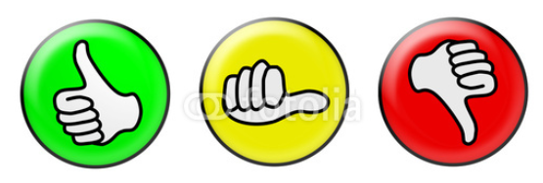
Grading
Time spent on project
Active participation in coaching/working blocks
Outcome at play-testing/final game
Team gets one grade
Team members distribute grade within team

Slide 7
Programing framework
C#
Mix of Java and C++
MS Visual Studio
Linux/MacOS guys can use mono, but have to convert final version (a.k.a. upload version)
Graphics: OpenGL graphics API (many details later)
OpenTK
C# wrapper for OpenGL
Sound: NAudio
Additional libs check with me first

Slide 8
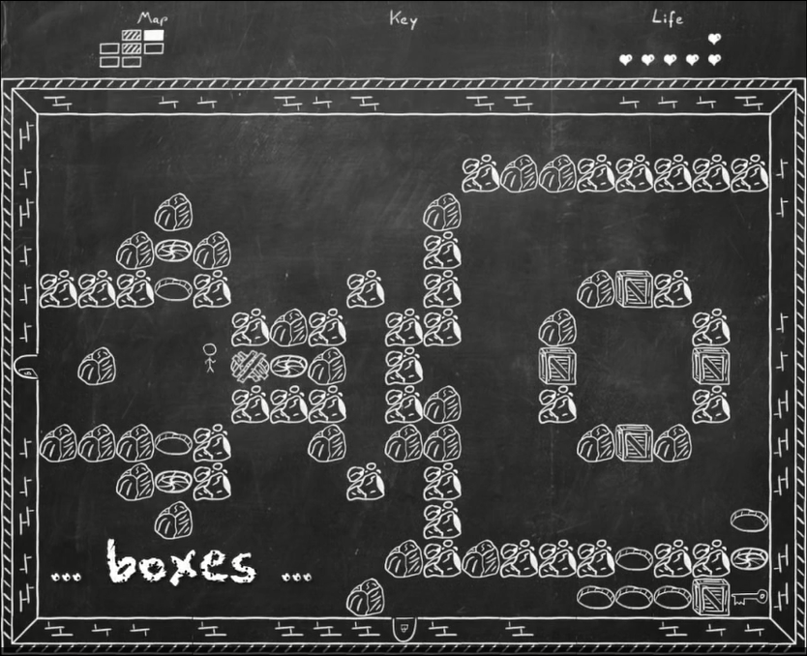
Project – 2D game
If existing game → introduce a twist
No exact copies allowed!
C# and OpenGL, no libs for rendering
Free textures/sprites/sounds from web ok

Slide 9
If you want to do a(nother) game
Excellent!
Possible with/without team
Informatikprojekt (5ects), MD projekte (5, 10, 15 ects)
Fachbereichsprojekt Spiele (3 or 5 ects)
Bachelor thesis (15 ects)
Master (xxx ects)

Slide 10

Resources at Github (goo.gl/924Jlv)
Slides
Tutorials
Framework
Links
Commented links on games and computer graphics
Google Calendar (goo.gl/SySLwF)
All Game Relevant Events (and more)
Moodle
Project/Example upload
Forums for questions

